Slide 1

Only Waste for Landfill
Isis

Slide 2

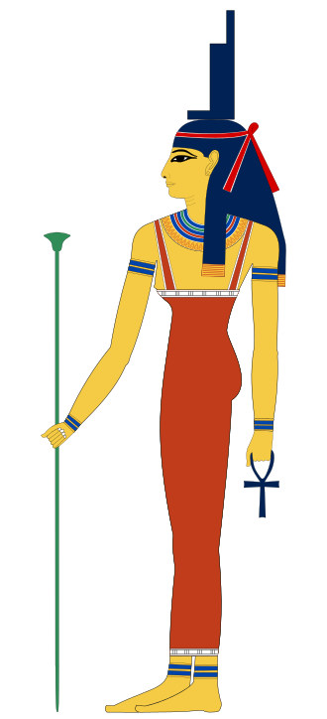
First, Team Name Isis is an ancient Egyptian mythic Goddess, who was supposed to be symbolized as magical healer, who was believed that bless the whole humankind with her mother nature .

Slide 3
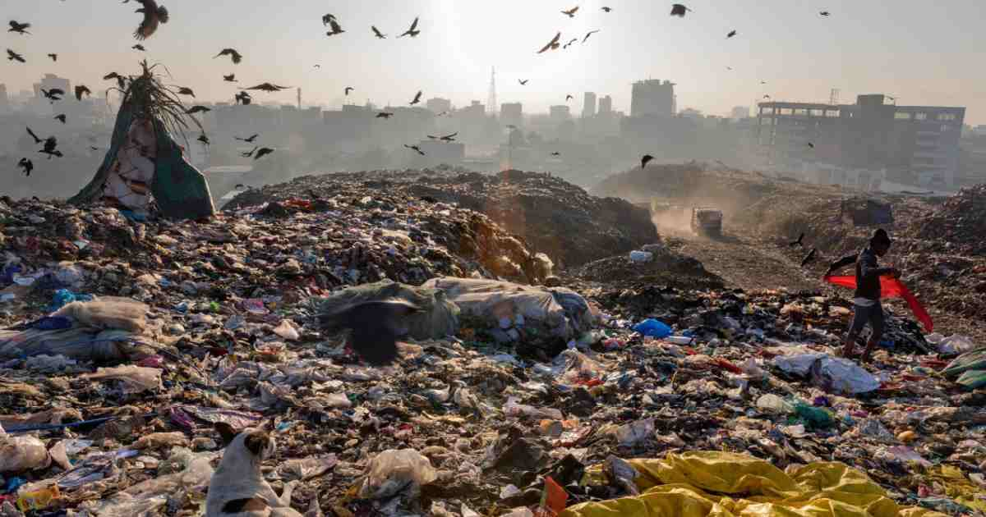
Waste is a “Waste” in the Wrong Place A huge population produce a huge waste. But is not its agony that the whole waste is treated as “WASTE” in our country?

Slide 4
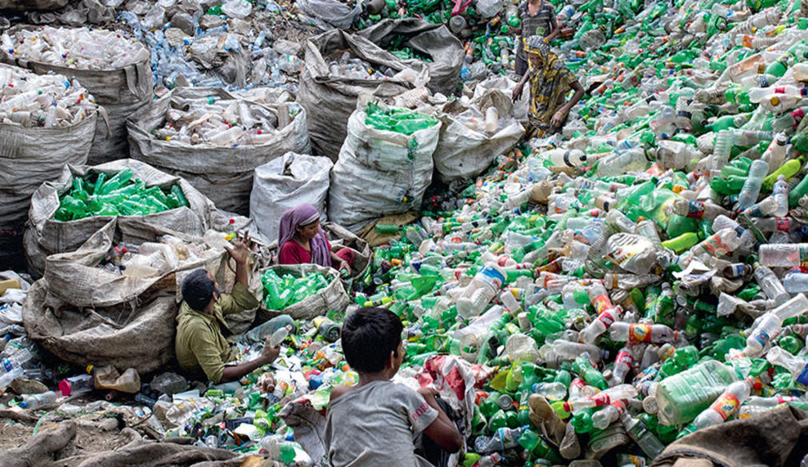
Are all waste is waste? We can’t treat plastic, paper, steel can as waste. Because all of them are recyclable. But unfortunately, they all are treated as waste in our country, which becomes liable to overload the whole landfills.

Slide 5
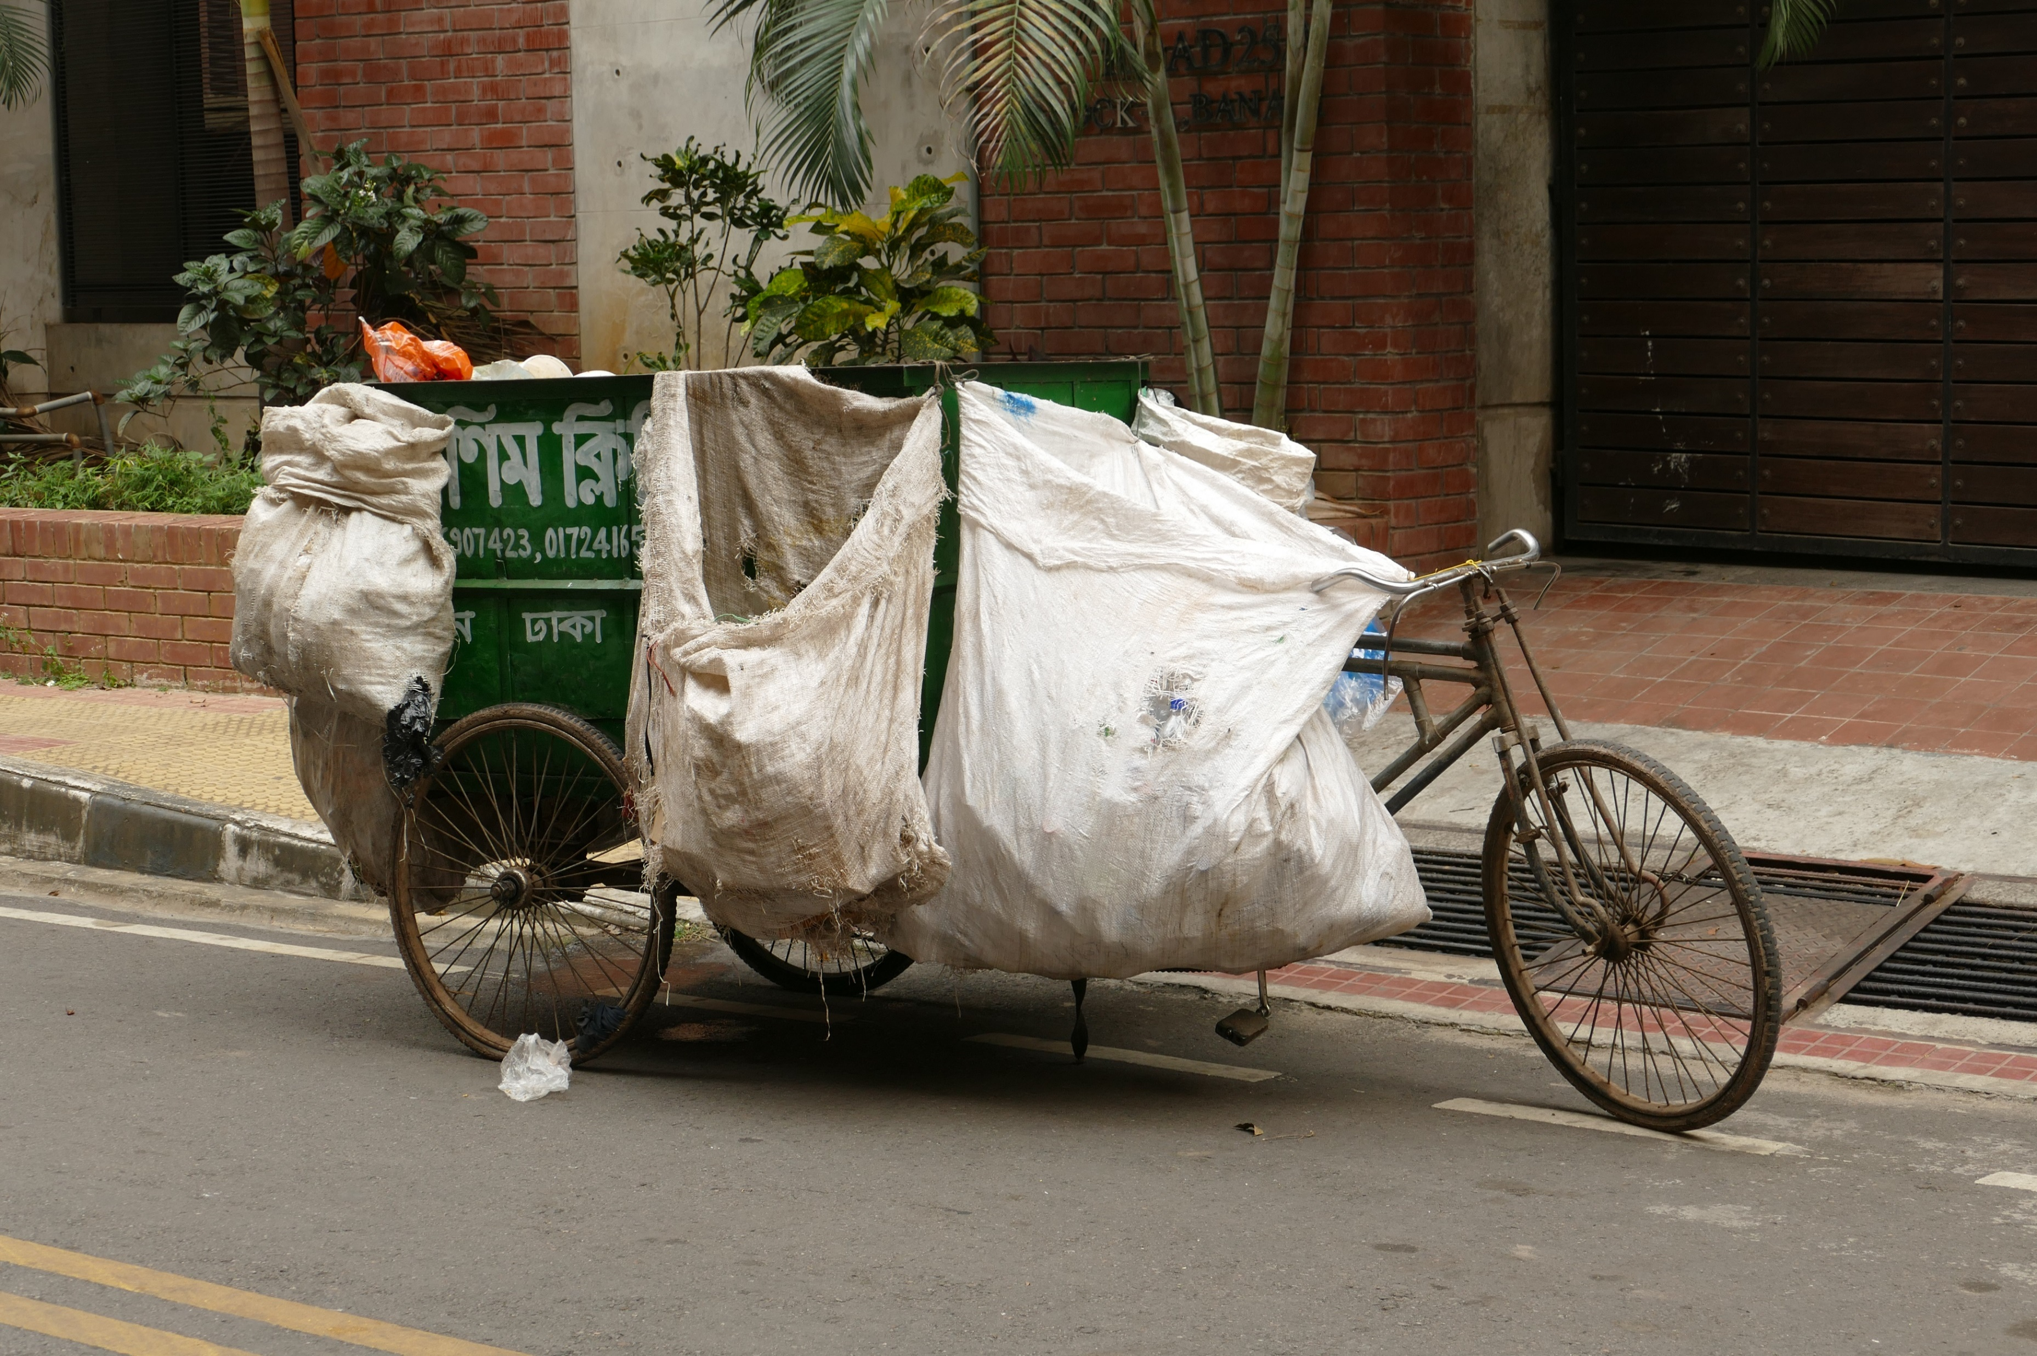
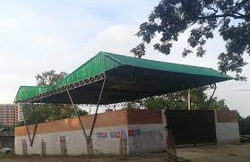
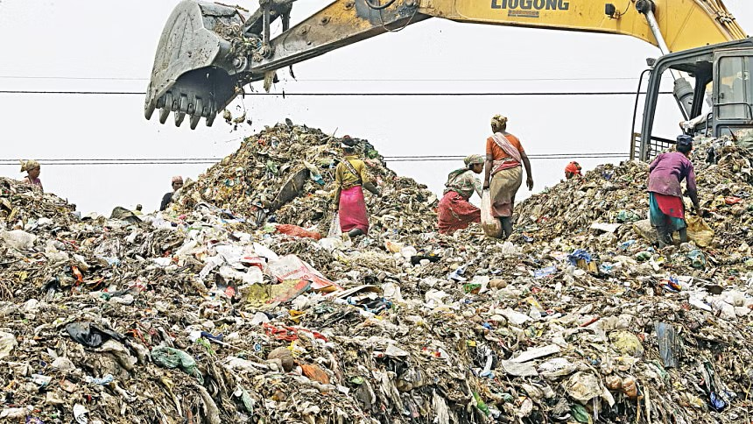
Basically, in Dhaka city, waste management flow is like that
Primary Collectors
Secondary Transfer Station (STS)
Landfill

Slide 6
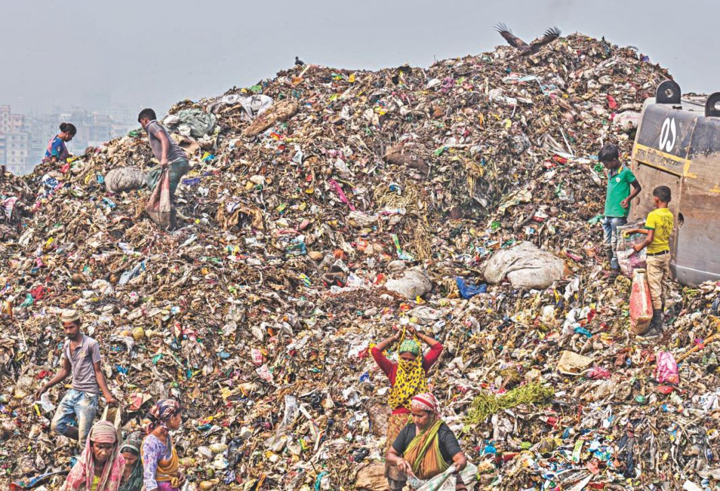
And at the end of this flow, our landfills are overloaded with the all things at raw phase.

Slide 7
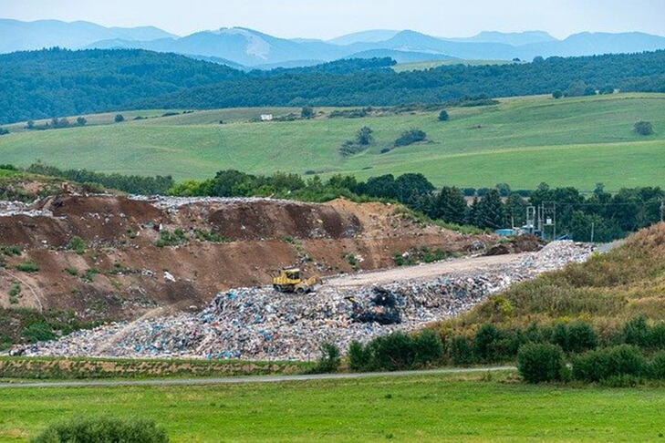

But can we convert our landfills only for being used to gather the “True Waste” and process?

Slide 8
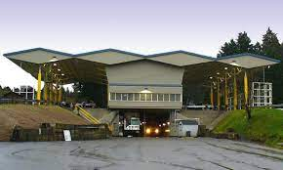
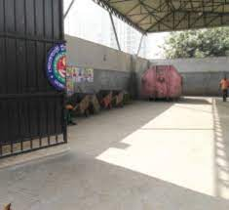
Actually, we can, via using the transformed secondary transfer stations from previous one

Slide 9
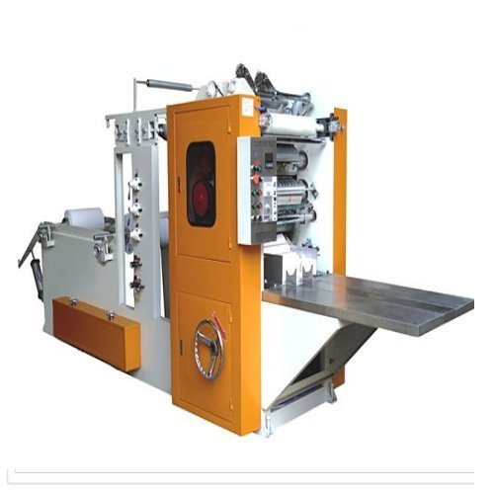
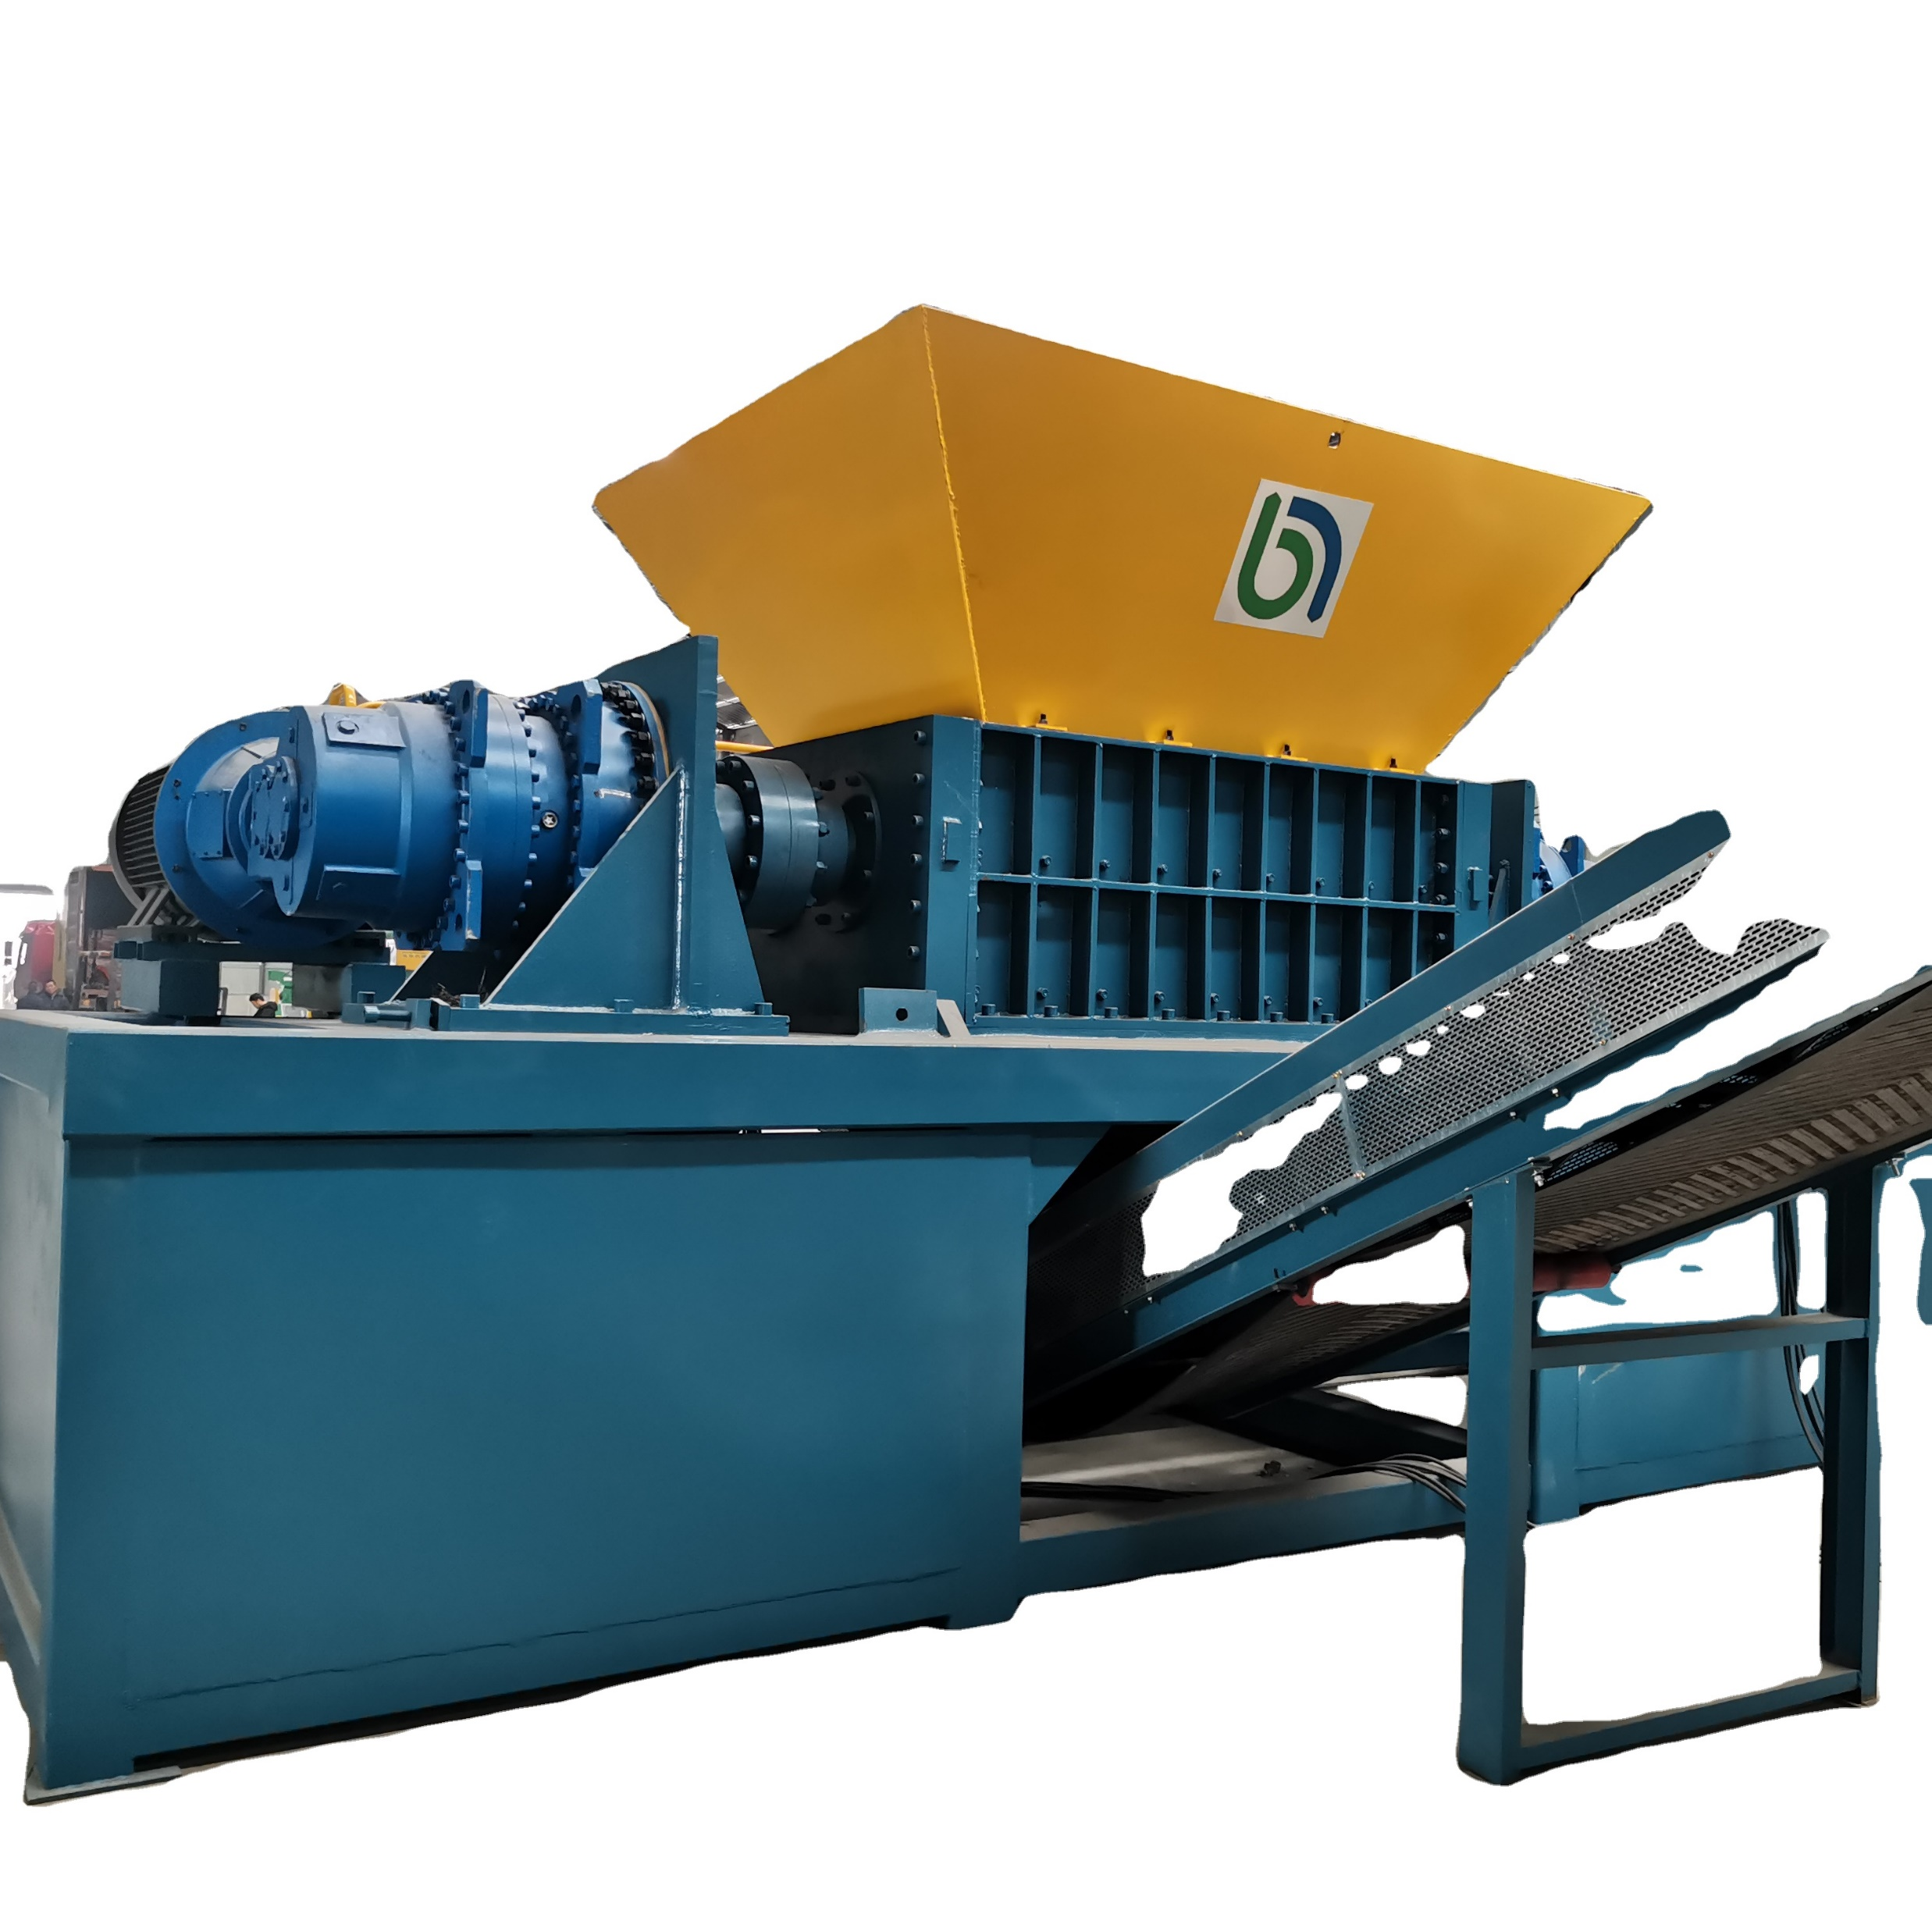
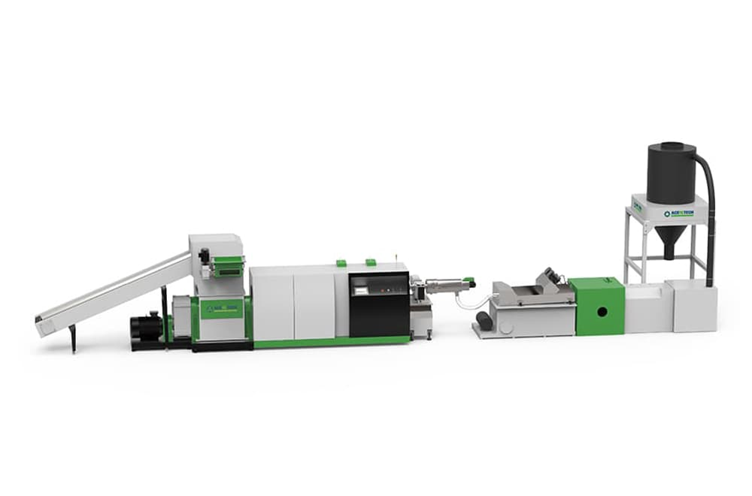
As we can’t consider the plastics, paper etc. as waste, because all of them are recyclable, we can handle them in these secondary transfer stations

Slide 10
A huge amount of plastic is gathered in the waste bin and STS and finally in landfills. If they are started to proceed in the STS by using this kind of machines “SHREDDER EXTRUDER RECYCLING PELLETIZING SYSTEM”, before felling in landfill a huge amount of waste load will be reduced.

Slide 11
Paper, must not be treated as waste, because they all are usable. We can install this type of machines in STSs.

Slide 12
Steel, Aluminum based used products are mostly responsible for overloading of waste. They are also processable and recyclable.

Slide 13
Landfill?
Cost
Mapping
We are proposing not to change the landfill, rather upgrading the existing infrastructure.
Even we don’t need to build up new stations.

Slide 14
Transportation?
Cost
Mapping
Cost would be reduced as we are working on existing facilities with stresses withdrawn.

Slide 15
Labor & wages?
Cost
Mapping
Our idea supports worker with technical training instead of higher qualification.
Even existing workers can be utilized.

Slide 16
Input Output Ratio?
Cost
Mapping
Machinery bases processing.
More Efficient & Time preserving.

Slide 17
Design Process?
Cost
Mapping
Not a headache at all. We just have to bear machinery and installation cost.

Slide 18
Probable Budget
Machinery System | Quantity | Price(Unit)
For Plastic | 03 | Tk. 8,000,000
For Paper | 02 | Tk. 5,000,000
For Steel | 01 | Tk. 6,000,000

Slide 19
In Dhaka metropolitan there is about 20 plus STS. So, the budget should be quite high for machinery (about Tk 800,000,000) and a huge enable manpower is needed. But there is an advantage that our infrastructure is built up.

Slide 20
Our Plans
For
Cost Recovery

Slide 21
One time investment
“Recyclable Products Marketing” under Government supervision
Transportation cost reduction

Slide 22
Recycled Products | Production Rate (Kg/hr) | Daily Estimated Mass (kg) | Unit Rate (Tk) | Yearly Revenue (TK)
Plastics | 160-220 | 1280 | 10 | 8672000
Paper | 9-15 | 70 | 16 | 408800
Metal | 62-70 | 500 | 250 | 45000000
Total |  |  |  | 53712880

Slide 23
Transportation cost
per 2 Ton/10 feet Garbage Truck- 2880Tk/ per Service
Assuming 10 Truck Services per STS, we can save 3 services per day.
Estimated Income: 2880x 3 x 20 x 365= 63072000 Tk (per year)
Economizing
Transportation

Slide 24
Estimated
Maintenance Cost
= 15000 x 12 x 20
= 3600000 Tk (per year)

Slide 26
Advantages
Recycle & Reuse
Environment Friendly
Eliminates Odor & Smoke
Reduced Stress on Landfill
Eliminates Non-decomposable Wastes
Opportunity for new income source

Slide 27
Drawbacks
Maintenance
Electric Hazards
Electrical connection & Maintenance
High cost

Slide 28
KPI
Safety
Quality
Cost
Productivity

Slide 29
As it is as usual that people fell their waste here & there, but somehow felt guilty.

Slide 30
If we install all these machine, this feeling of waste disposal will not as much affect as the whole process and land fills will be rescued from the over loading and we would transport there only the true waste in the landfill, which can’t be processed in the STSs.

Slide 31
Thank you everyone
if there is any question ,
please proceed.

